Slide 1
Travel Management System
NAME: ROLLNO:
U.AMITH SAI 2451-12-733-044
P.ROHITH 2451-12-733-045
P.LAVANYA 2451-12-733-053

Slide 2
Why Travel Management System ?
One of the important feature of this application is it works online. Users can book using this application it will save time, reduce cost and provide planned traveling.
Using this application traveling agencies can give clear picture on fares and hotels and vehicles information.
Travel agency can generate Report on weekly and monthly basis on booking details. Which will give clear idea on booking status.

Slide 3
Introduction
The present project deals with development of a Travel Management System (TMS).
It is mainly designed for tourism management companies for easily managing travelers’ details and reserve the vehicle as per the schedule.
Users can book using this application it will save time and provide planned travelling.

Slide 4
Salient Features
Customer Relationship Management
Enquiry Management
Tour Management & Other Services
Online Payment Gateway
Ticketing
Financial Management.

Slide 5
What we used?
For developing this project we learned and used these topics
HTML:
HTML Elements, HTML Attributes, HTML Headings, HTML Paragraphs, HTML Styles, HTML Formatting, HTML Quotations, HTML Comments, HTML CSS, HTML Links, HTML Images.
JAVASCRIPT :
JS Syntax, JS Statements, JS Comments, JS Variables, JS Operators, JS Data Types.
ASP

Slide 6
This is how it works
This website works as follows. First the user reads the travel agency's rules and Regulations
.Next user checks the fares of each type of vehicle and also the maximum number of passengers
those can travel in the vehicle selected. After checking the details of the vehicles user proceeds
for the booking webpage .In this user gives his information like name, date of journey, contact
number, email id, source, destination type of vehicle etc. ,Once user enters his information
and clicks the submit button the details that are entered by user are validated and if there is
anything in the wrong format the system gives an alert that something entered by the user is
empty .And if all the details are correct then the system acknowledges the user by displaying the information entered
by the user. This
information is stored in the data base for future useong or user has not entered anything or left it empty

Slide 7
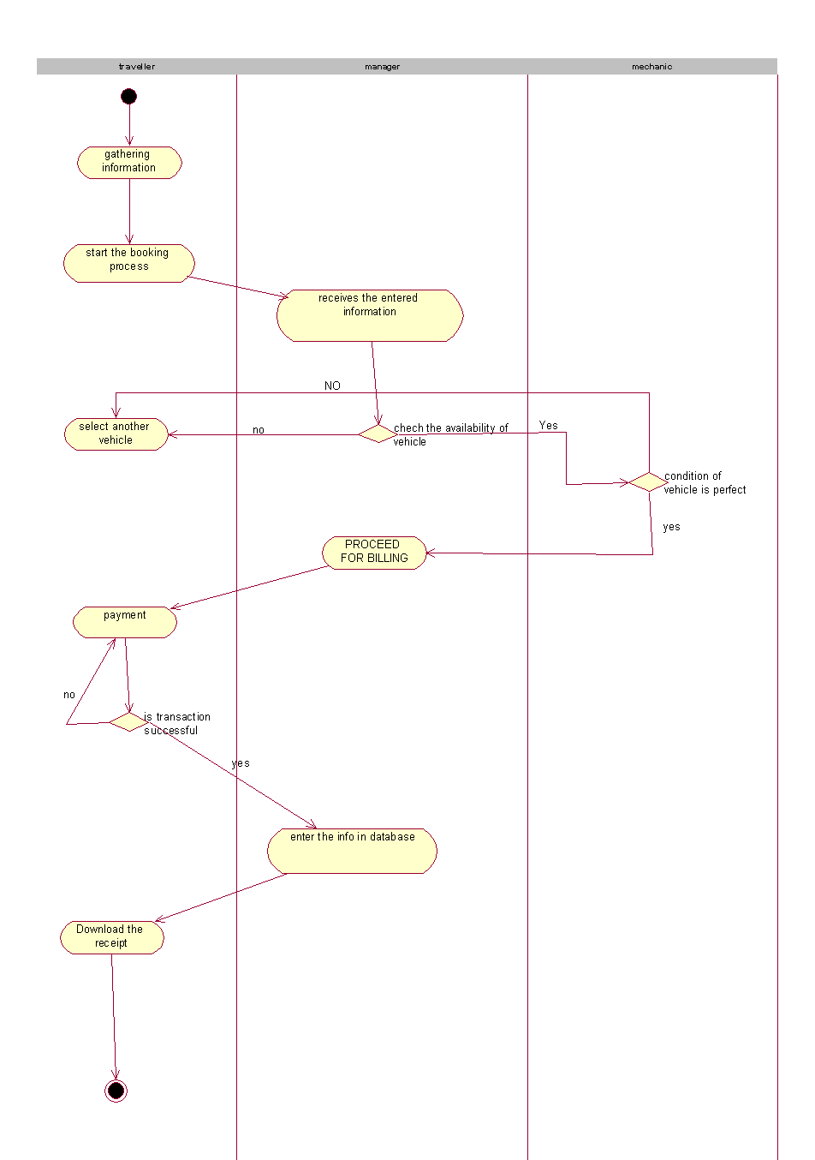
Flow chart

Slide 8
Data Mapping
TMS is designed in such a manner that it takes care of the following things:
Ease of Data Entry as all transactions are mapped to standard tables thus providing a lot of control thus eliminating user data entry errors to a large extent.
2. Strong categorization of standard tables to enable Management with user Reporting
3. Master Clean Up which should be done at least once a month to remove all duplicate and redundant data in the standard tables
Typical standard tables are Resort, Resort Type, Service Type, City, State, Country etc.

Slide 9
Enquiry Management
Enquiry to a Travel House originates from various sources:
Email
Fax
Walk – In
Telephonic
All enquiries are entered into a system through a customized form except online enquiries.
These enquiries are entered and handed over to the customer service person to follow up.
The tasks to be performed on an enquiry are:
Assign
Forward
Share

Slide 10
Booking Process Module
All enquiries which get confirmed get converted into a reservation which could be for ticketing.
The ticketing data will be entered into the system directly with the payment details.
Similarly, other services like vehicle rental will be directly entered into the system directly with the payment collection details.
Based on this, the respective invoices can be generated for the customer.
The system also takes care of cancellation of reservations.

Slide 11
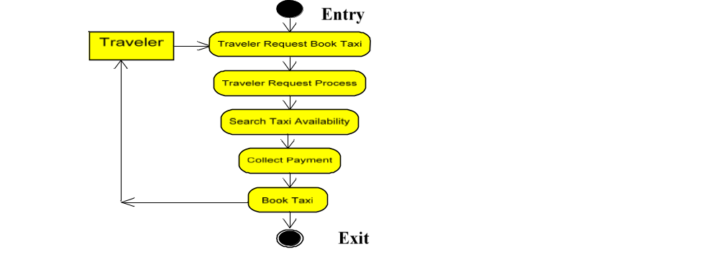
Activity Diagram

Slide 12
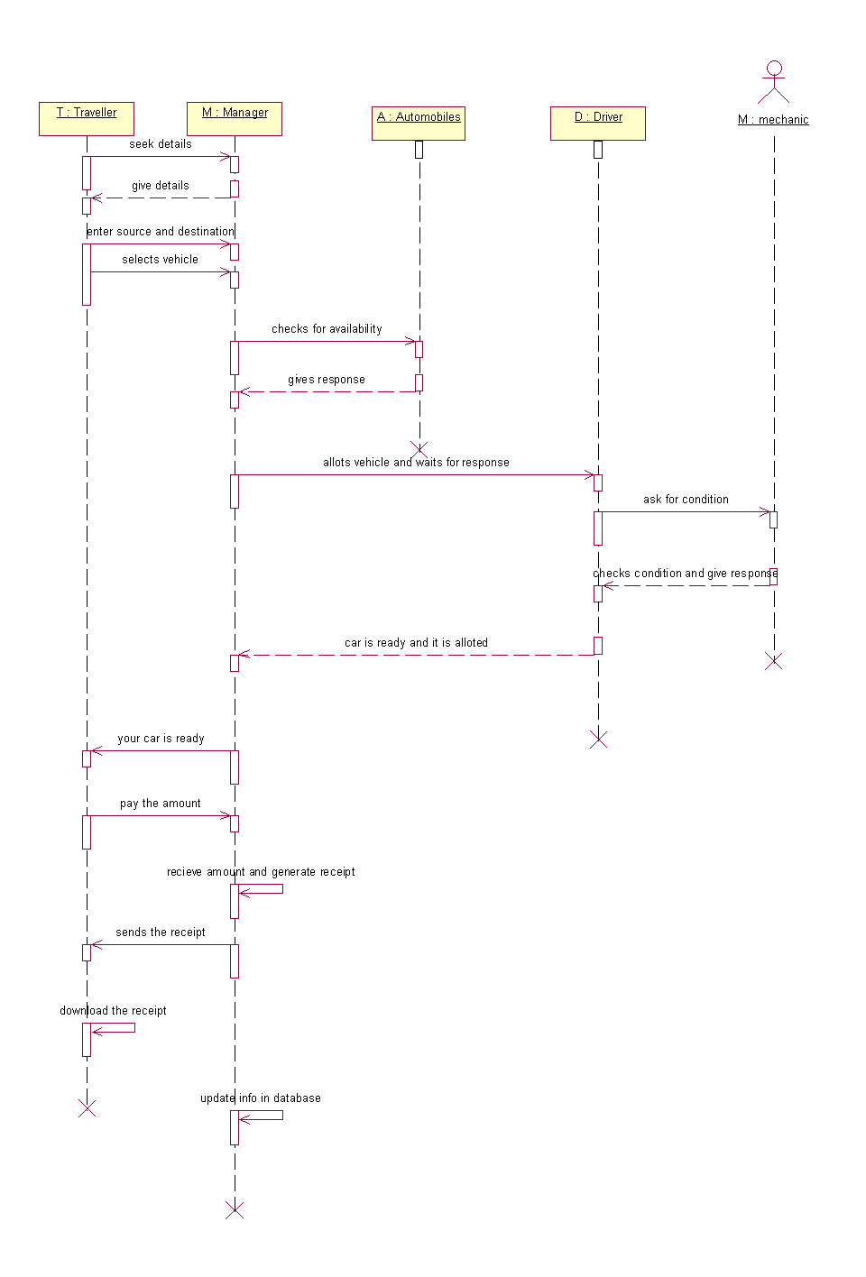
Sequence diagram

Slide 13
Payment Module
The payment towards the booking comes in this form:
Payments via online payment gateways which includes bank, pay pal etc.
There is a module to automatically reconcile with the payment
gateways and update this data into the Accounts Module

Slide 14
Financial Management
The key features of this module are:
Automatic transfer of data from Online Payment Gateways
Costing
Automatic Calculation of Exchange Gain / Loss
Auto Calculation of Vendor Commission and reconciling of statements through the system
Bank Reconciliation

Slide 15
Thank You

